Slide 2
Hello everyone
All English/maths lessons follow on from the previous day.
Remember you can email any of your work for us to see at
Year4@westfield.staffs.sch.uk
.

Slide 3
Monday Maths lesson 1 week beginning June 1st 2020
Week 1
Scroll to the bottom and click on summer week 1 Make a Whole
Demonstration click on left hand side of page for demo before clicking on activity or answers ( see next slide)
https://whiterosemaths.com/homelearning/year-4/
Week 1 lesson 1
Questions
https://wrm-13b48.kxcdn.com/wp-content/uploads/2020/homelearning/year-4/Lesson-1-Y4-Summer-Block-1-WO1-Make-a-whole-2020.pdf
Answer sheet
https://wrm-13b48.kxcdn.com/wp-content/uploads/2020/homelearning/year-4/Lesson-1-Y4-Summer-Block-1-ANS1-Make-a-whole-2020.pdf
Learning Objective
To make a whole
Steps to Success:
Listen to demonstration first
1. Draw your place value chart ( see demonstration)
2. When dividing by 10, numbers move one place to the right
3. When dividing by 100, numbers move 2 places to the right
4. When multiplying by 10, numbers move one place to the right
5. When multiplying by 100, numbers move 2 places to the right
6. Check
Notes:
Odd and even numbers recapped due to following part of session
Support given to PP first and boys
teacher/ta work with LA group to support – teach how to answer

Slide 5
Monday English
Learning Objective
Read story and know definition of words
Steps to Success:
1. Listen to/read the story.
2. Read the definitions of the words.
3. Look at the pictures and decide which picture goes with each word.
4. Complete alien word game.
(follow example on p. 5)
6. Check
English
‘Amazing Aliens’
https://www.talk4writing.co.uk/wp-content/uploads/2020/04/Y4-Maria-Aliens.pdf
Click on the above link and follow all demonstrations and activities
Pages of unit 1-5
Notes:
Odd and even numbers recapped due to following part of session
Support given to PP first and boys
teacher/ta work with LA group to support – teach how to answer

Slide 6
Monday
Spelling https://content.twinkl.co.uk/resource/b1/a1/T2-E-41609-Year-3-and-4-Statutory-Spelling-Words-Activity-Mat-2-Resource-Pack-English_ver_1.pdf?__token__=exp=1589124417~acl=%2Fresource%2Fb1%2Fa1%2FT2-E-41609-Year-3-and-4-Statutory-Spelling-Words-Activity-Mat-2-Resource-Pack-English_ver_1.pdf%2A~hmac=0756079d1504a8f947f3b06b3264da6cac140131a67f988bee94dcb48c237d8a
Learning Objective- To spell words from the statutory list
Steps to success
1.Use a dictionary to find the meaning of the word
2. Which word class does the word belong to? (see word mat)
3. Complete sentences
4. How many syllables does it have?
Complete all activities on the sheet below the spelling sheet
A syllable is a single, unbroken sound of a spoken (or written) word. Syllables usually contain a vowel and accompanying consonants. The number of times you hear a vowel (a, e, i , o, u) in a word is equal to the number of syllables a word has.
5. Spell the word
6. Edit the words
7. Write your own sentence with the word in

Slide 8
Monday spelling activities

Slide 9
Monday Topic ART
Learning Objective
Use observational skills to draw in the style of a famous artist
Steps to Success:
Follow instructions from link
Please send us photos of your completed pictures we would love to see them.
Observational drawing
Learn how to draw in the style of Rob Biddulph famous author and illustrator.
Click on link
http://www.robbiddulph.com/draw-with-rob
Scroll down to self portrait number 9
Follow instructions on screen
Notes:
Odd and even numbers recapped due to following part of session
Support given to PP first and boys
teacher/ta work with LA group to support – teach how to answer

Slide 10
Tuesday Maths lesson 2
Learning Objective
Write decimals
Steps to Success:
1. Watch demonstration.
2. Complete place value charts.
3. Complete sentences to describe each number.
4. Remember to write a zero for the place holder.
4. Complete part, part whole , making sure numbers add up to a whole
5.Answer all questions
6. Check
Demonstration click on left hand side of page for demo before clicking on activity or answers ( see next slide)
https://whiterosemaths.com/homelearning/year-4/
Lesson 2
Questions
https://wrm-13b48.kxcdn.com/wp-content/uploads/2020/homelearning/year-4/Lesson-2-Y4-Summer-Block-1-WO2-Write-decimals-2020.pdf
Answer sheet
https://wrm-13b48.kxcdn.com/wp-content/uploads/2020/homelearning/year-4/Lesson-2-Y4-Summer-Block-1-ANS2-Write-decimals-2020.pdf
Notes:
Odd and even numbers recapped due to following part of session
Support given to PP first and boys
teacher/ta work with LA group to support – teach how to answer

Slide 11
Tuesday English
Learning Objective
To use a dictionary to find definitions of words
Steps to Success:
1. Re read information on ‘Aliens’ again.
2. Underline unfamiliar words that you do not know the meaning of.
3. Find the definition – use a dictionary if you have one.
4. Write your definitions out on a separate piece of paper.
5. Put them into a sentence.
6. Check
English
‘Amazing Aliens’
https://www.talk4writing.co.uk/wp-content/uploads/2020/04/Y4-Maria-Aliens.pdf
What do the word mean
Pages of unit p 6 ( top part only)
Notes:
Odd and even numbers recapped due to following part of session
Support given to PP first and boys
teacher/ta work with LA group to support – teach how to answer

Slide 12
Tuesday
Spelling https://content.twinkl.co.uk/resource/b1/a1/T2-E-41609-Year-3-and-4-Statutory-Spelling-Words-Activity-Mat-2-Resource-Pack-English_ver_1.pdf?__token__=exp=1589124417~acl=%2Fresource%2Fb1%2Fa1%2FT2-E-41609-Year-3-and-4-Statutory-Spelling-Words-Activity-Mat-2-Resource-Pack-English_ver_1.pdf%2A~hmac=0756079d1504a8f947f3b06b3264da6cac140131a67f988bee94dcb48c237d8a
Learning Objective- To spell words from the statutory list
Steps to success
1.Use a dictionary to find the meaning of the word
2. Which word class does the word belong to? (see word mat)
3. Complete sentences
4. How many syllables does it have?
Complete all activities on the sheet below the spelling sheet
A syllable is a single, unbroken sound of a spoken (or written) word. Syllables usually contain a vowel and accompanying consonants. The number of times you hear a vowel (a, e, i , o, u) in a word is equal to the number of syllables a word has.
5. Spell the word
6. Edit the words
7. Write your own sentence with the word in

Slide 14
Tuesday spelling activities

Slide 15
Tuesday Topic Science
Learning Objective
To name the different types of human teeth.
Steps to Success:
Watch the video
Make note of the names of the different types of human teeth.
Learn about the jobs of each type of tooth.
Label the mouth with the correct names of the teeth.
If you can print out the colures mouth and stick on the teeth.
Watch the video
https://www.youtube.com/watch?v=ZE-TtFhZlDw
Diagram to label is on the next slide.
Notes:
Odd and even numbers recapped due to following part of session
Support given to PP first and boys
teacher/ta work with LA group to support – teach how to answer

Slide 16
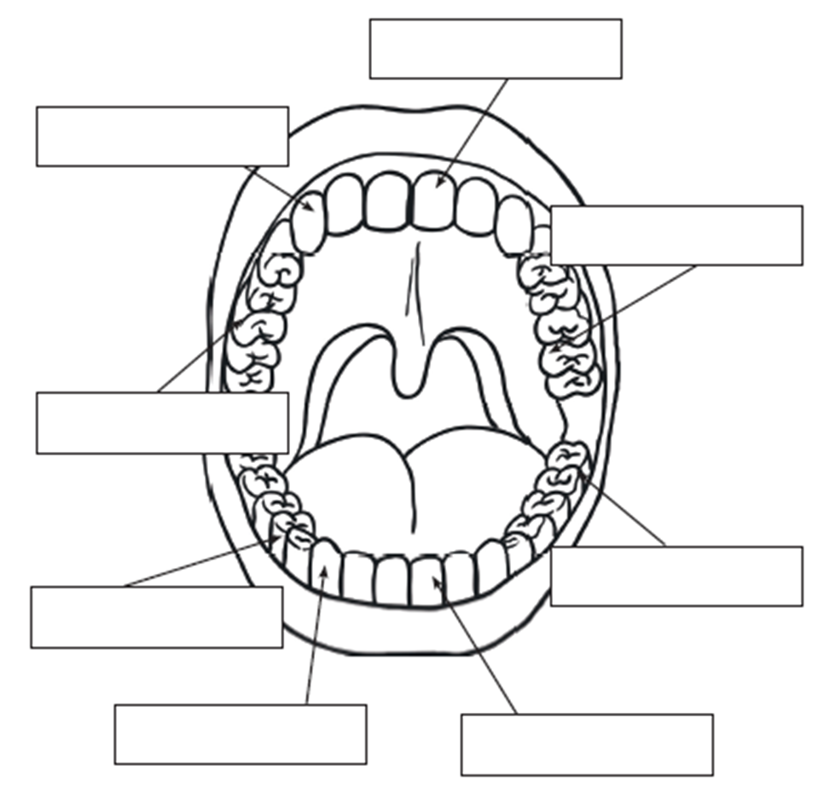
Drag the words into the correct box.
Incisor
Incisor
Canine
Canine
Molar
Molar
Premolar
Premolar

Slide 17
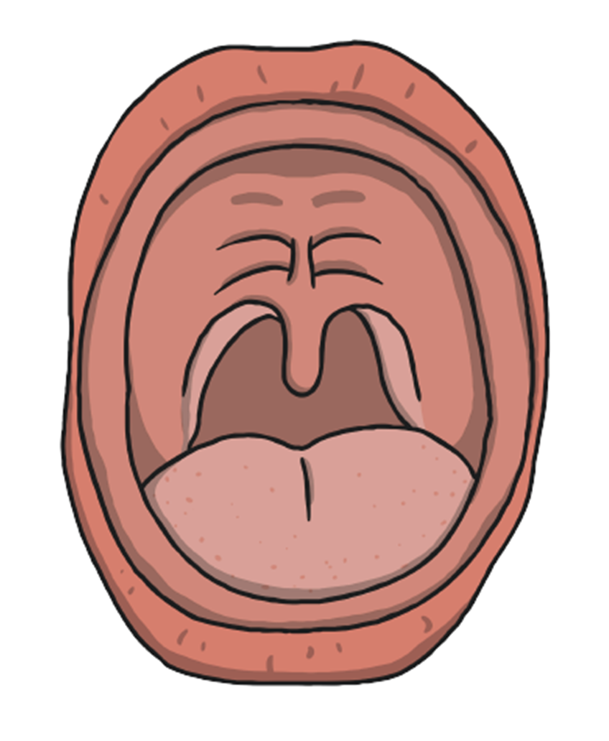
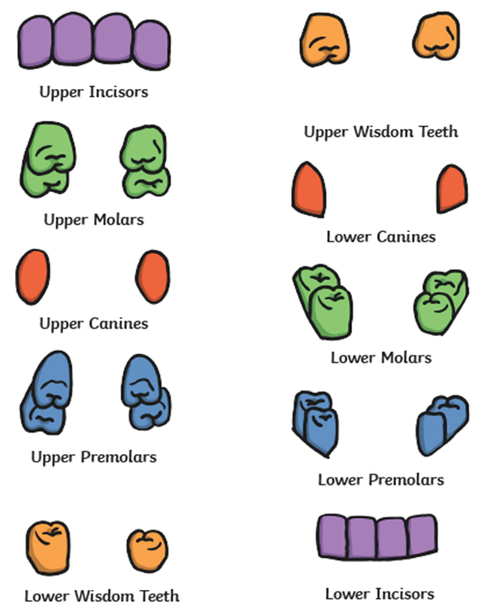
If you have chance you can print out this mouth, cut out and stick the teeth in the correct place.

Slide 18
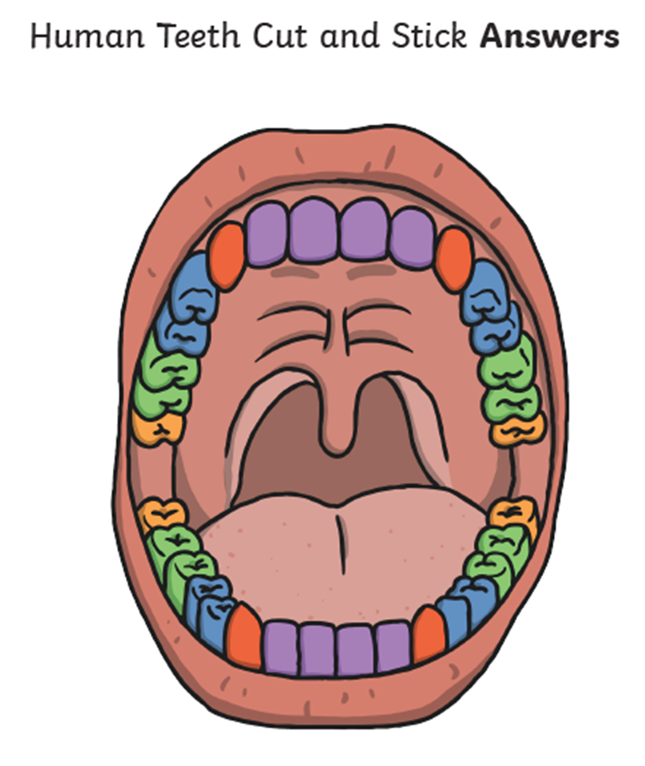

Slide 19
Wednesday Maths lesson 3
Learning Objective
Compare decimals
Steps to Success:
Watch demonstration.
1. Look at the numbers on the place value grids.
2. Add < or > to show greater than or less than
3. Complete all questions.
4. Check
Demonstration click on left hand side of page for demo before clicking on activity or answers ( see next slide)
https://whiterosemaths.com/homelearning/year-4/
Lesson 3
Questions
https://wrm-13b48.kxcdn.com/wp-content/uploads/2020/homelearning/year-4/Lesson-3-Y4-Summer-Block-1-WO3-Compare-decimals-2020.pdf
Answer sheet
https://wrm-13b48.kxcdn.com/wp-content/uploads/2020/homelearning/year-4/Lesson-3-Y4-Summer-Block-1-ANS3-Compare-decimals-2020.pdf
Notes:
Odd and even numbers recapped due to following part of session
Support given to PP first and boys
teacher/ta work with LA group to support – teach how to answer

Slide 20
Wednesday English
Learning Objective
To use comprehension skilss to answer question about a text
Steps to Success:
1. Read questions
2. Find the answers in the text.
3. Then write your answers in full sentences using a capital and a full stop.
4. Read question again then read your answer to see if it relates to the question.
6. Check
English
‘Amazing Aliens’
https://www.talk4writing.co.uk/wp-content/uploads/2020/04/Y4-Maria-Aliens.pdf
Comprehension
Pages of unit p5/6
Notes:
Odd and even numbers recapped due to following part of session
Support given to PP first and boys
teacher/ta work with LA group to support – teach how to answer

Slide 21
Wednesday
Spelling https://content.twinkl.co.uk/resource/b1/a1/T2-E-41609-Year-3-and-4-Statutory-Spelling-Words-Activity-Mat-2-Resource-Pack-English_ver_1.pdf?__token__=exp=1589124417~acl=%2Fresource%2Fb1%2Fa1%2FT2-E-41609-Year-3-and-4-Statutory-Spelling-Words-Activity-Mat-2-Resource-Pack-English_ver_1.pdf%2A~hmac=0756079d1504a8f947f3b06b3264da6cac140131a67f988bee94dcb48c237d8a
Learning Objective- To spell words from the statutory list
Steps to success
1.Use a dictionary to find the meaning of the word
2. Which word class does the word belong to? (see word mat)
3. Complete sentences
4. How many syllables does it have?
Complete all activities on the sheet below the spelling sheet
A syllable is a single, unbroken sound of a spoken (or written) word. Syllables usually contain a vowel and accompanying consonants. The number of times you hear a vowel (a, e, i , o, u) in a word is equal to the number of syllables a word has.
5. Spell the word
6. Edit the words
7. Write your own sentence with the word in

Slide 23
Wednesday spelling activities

Slide 24
Wednesday Topic Science
Learning Objective
To explain why animals need different teeth
Steps to Success:
1.Watch the video clip
2. Explain herbivore, carnivore and
omnivore
3. Describe their teeth
4. Explain why they need different teeth
Watch the video
https://www.youtube.com/watch?v=VejLXTsJrJc
Go through the slides and guess which animals the skulls belong to and whether it is a herbivore, carnivore or omnivore by linking the foods they eat to the types of teeth they have.
Notes:
Odd and even numbers recapped due to following part of session
Support given to PP first and boys
teacher/ta work with LA group to support – teach how to answer

Slide 25
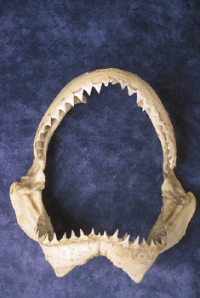
Which animal’s teeth? Herbivore, omnivore or carnivore?
Shark Carnivore
© SaveTeachersSundays.com 2013
Images © clipart.com 2013

Slide 26
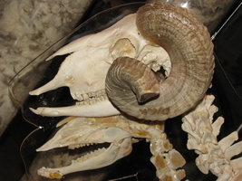
Which animal’s teeth? Herbivore, omnivore or carnivore?
Goat Herbivore
© SaveTeachersSundays.com 2013
Images © clipart.com 2013

Slide 27
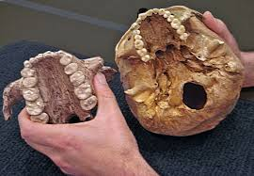
Which animal’s teeth? Herbivore, omnivore or carnivore?
Human Omnivore
© SaveTeachersSundays.com 2013
Images © clipart.com 2013

Slide 28
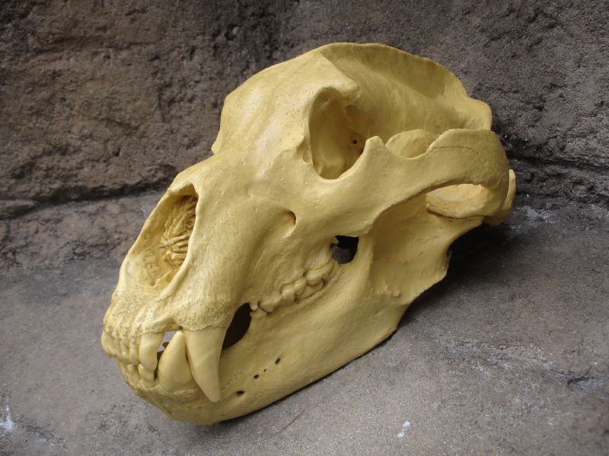
Which animal’s teeth? Herbivore, omnivore or carnivore?
Bear Omnivore
© SaveTeachersSundays.com 2013
Images © clipart.com 2013

Slide 29
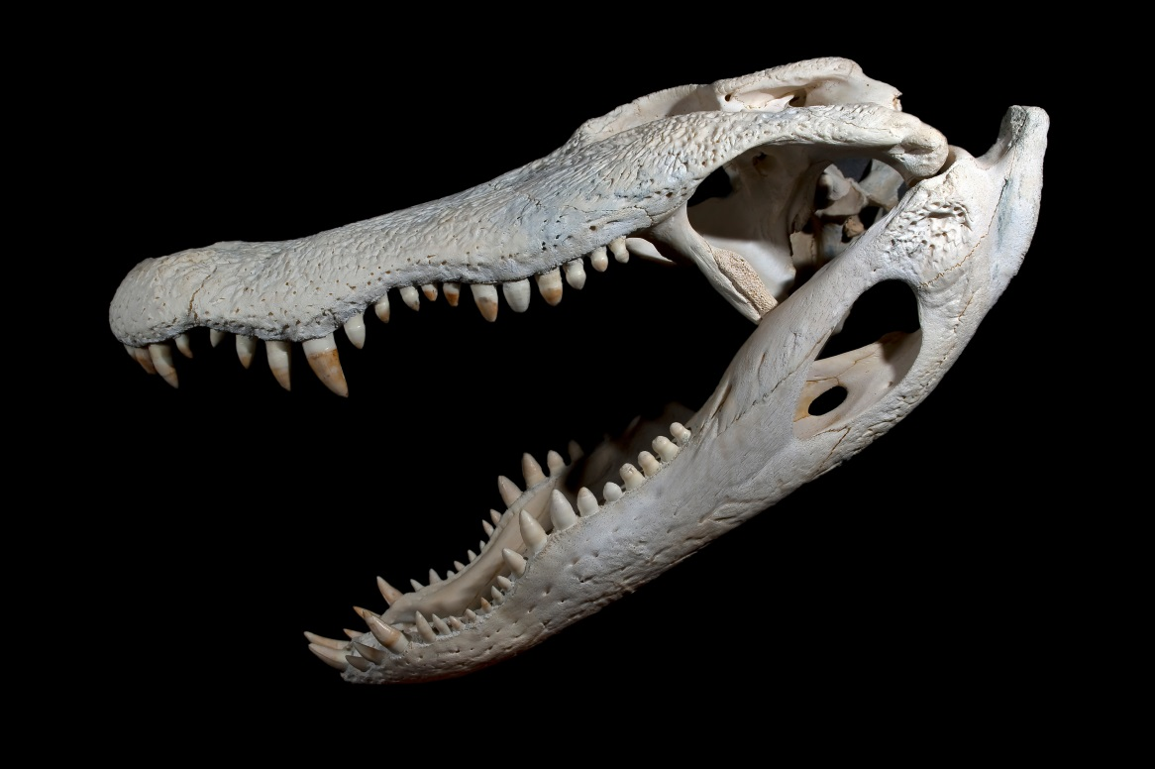
Which animal’s teeth? Herbivore, omnivore or carnivore?
Alligator Carnivore
© SaveTeachersSundays.com 2013
Images © clipart.com 2013

Slide 30
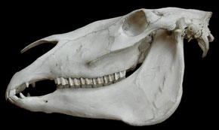
Which animal’s teeth? Herbivore, omnivore or carnivore?
Horse Herbivore
© SaveTeachersSundays.com 2013
Images © clipart.com 2013

Slide 31
Now explain why animals need different types of teeth.
© SaveTeachersSundays.com 2013
Images © clipart.com 2013

Slide 32
Thursday Maths lesson 4
Learning Objective
Order decimals
Steps to Success:
Watch demonstration
1. Look at the numbers on place value grid
2. What number is represented in each place value grid
3. Then write the numbers in order.
( ascending , smallest to largest or descending numbers, largest to smallest)
4. Solve problems
5. Check
Demonstration click on left hand side of page for demo before clicking on activity or answers ( see next slide)
https://whiterosemaths.com/homelearning/year-4/
Questions
https://wrm-13b48.kxcdn.com/wp-content/uploads/2020/homelearning/year-4/Lesson-4-Y4-Summer-Block-1-WO4-Order-decimals-2020.pdf
Answer sheet
https://wrm-13b48.kxcdn.com/wp-content/uploads/2020/homelearning/year-4/Lesson-4-Y4-Summer-Block-1-ANS4-Order-decimals-2020.pdf
Notes:
Odd and even numbers recapped due to following part of session
Support given to PP first and boys
teacher/ta work with LA group to support – teach how to answer

Slide 33
Thursday English
Learning Objective
Use two adjectives to describe the alien, remembering to put a comma in between the two adjectives
Steps to Success:
1. Read instructions.
2. Write 2 adjectives.
3. Make sure there is a comma between them.
4. Use different adjectives every time.
Extension – write sentences using your adjectives.
6. Check
English
‘Amazing Aliens’
https://www.talk4writing.co.uk/wp-content/uploads/2020/04/Y4-Maria-Aliens.pdf
Adjective Game
Pages of unit p 7
Notes:
Odd and even numbers recapped due to following part of session
Support given to PP first and boys
teacher/ta work with LA group to support – teach how to answer

Slide 34
Thursday
Spelling https://content.twinkl.co.uk/resource/b1/a1/T2-E-41609-Year-3-and-4-Statutory-Spelling-Words-Activity-Mat-2-Resource-Pack-English_ver_1.pdf?__token__=exp=1589124417~acl=%2Fresource%2Fb1%2Fa1%2FT2-E-41609-Year-3-and-4-Statutory-Spelling-Words-Activity-Mat-2-Resource-Pack-English_ver_1.pdf%2A~hmac=0756079d1504a8f947f3b06b3264da6cac140131a67f988bee94dcb48c237d8a
Learning Objective- To spell words from the statutory list
Steps to success
1.Use a dictionary to find the meaning of the word
2. Which word class does the word belong to? (see word mat)
3. Complete sentences
4. How many syllables does it have?
Complete all activities on the sheet below the spelling sheet
A syllable is a single, unbroken sound of a spoken (or written) word. Syllables usually contain a vowel and accompanying consonants. The number of times you hear a vowel (a, e, i , o, u) in a word is equal to the number of syllables a word has.
5. Spell the word
6. Edit the words
7. Write your own sentence with the word in

Slide 36
Thursday spelling activities

Slide 37
Thursday Topic Science
Learning Objective
To think how different liquids can cause tooth decay
Go through the power point questions and set up your own scientific enquiry.
Steps to Success:
To ask scientific questions and choose a scientific enquiry to answer them.
To create an enquiry or test.
To set up a simple enquiry with support.
To make predictions and suggest equipment.
To give clear instructions to perform a test.
Notes:
Odd and even numbers recapped due to following part of session
Support given to PP first and boys
teacher/ta work with LA group to support – teach how to answer

Slide 38
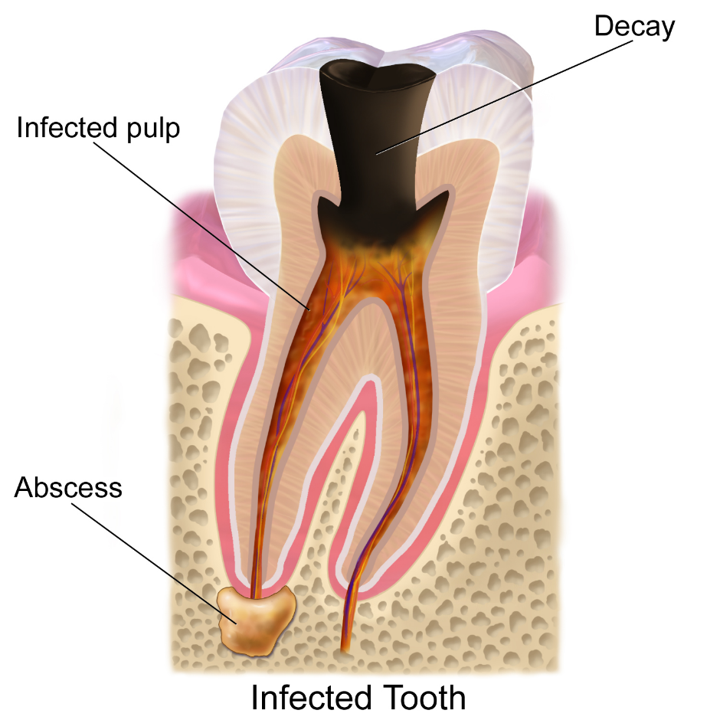
Tooth Decay
Discuss the following questions with your talk partner:
What is tooth decay?
What causes tooth decay?
How do you know?
Image courtesy of BruceBlaus (@Wikipedia.com) - granted under creative commons licence – attribution

Slide 39
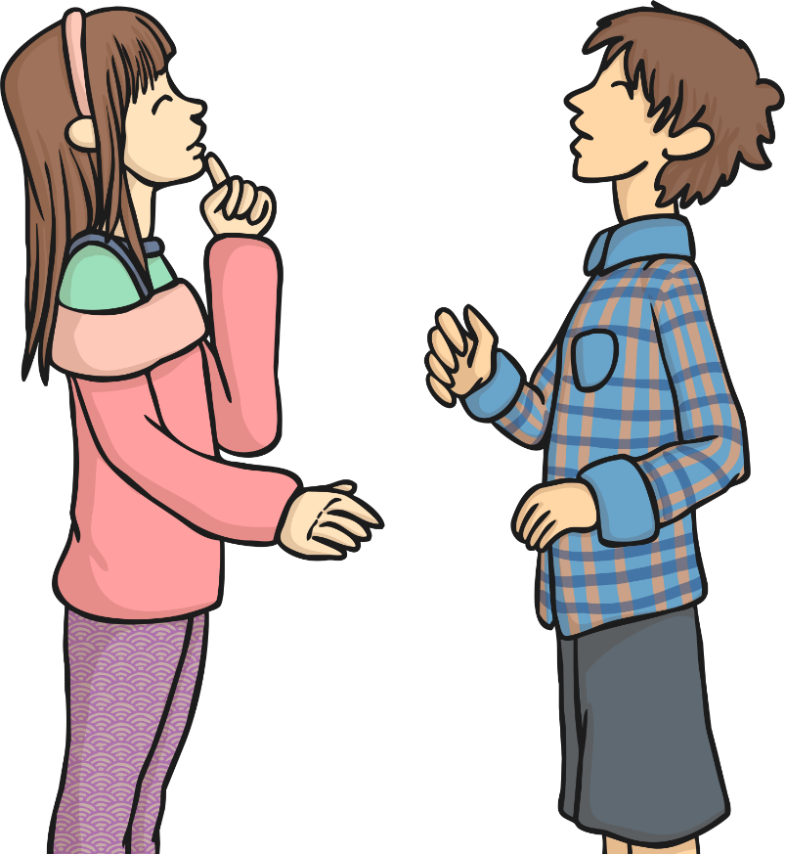
Questions!
Scientific Enquiry
Why do scientists ask questions?
Why do they carry out enquiries and tests?

Slide 40
Scientific or Not?
Categorise the questions based on whether they are scientific questions that can be tested or whether they are non-scientific questions:
Scientific Questions | Non-Scientific Questions
Does eating fruit keep you healthy?
How much sleep do rabbits need?
What time is dinner?
Does water always boil when heated?
Can you open the lid?
When should I do my homework?
Does sound travel through walls?
Do plants need soil to grow?

Slide 41
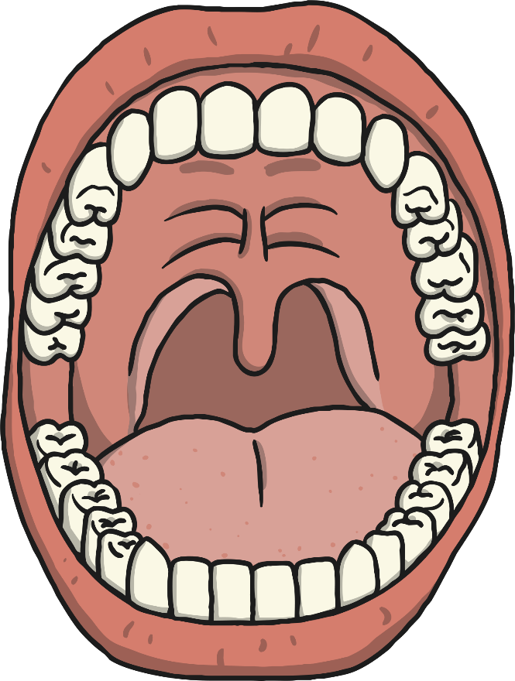
Creating Scientific Questions
Now we need to generate some scientific questions about tooth decay.
Remember we need to be able to test them so…
think about the equipment you would need
think about how the test would need to be carried out
OUR SCIENTIFIC QUESTIONS:
?

Slide 42
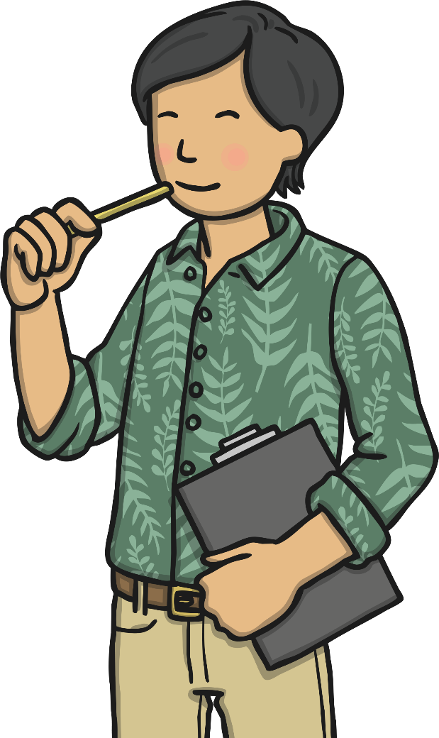
Types of Enquiries
What types of scientific enquiries are there?
Can you give examples of scientific enquiries or tests you have done?
How would you know what type of enquiry to choose?
We are going to look at some examples of questions and the kind of enquiries we could use to answer them.

Slide 43
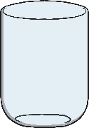
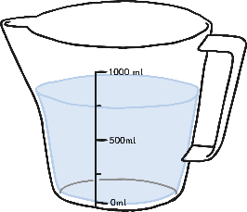
Practical Enquiries
A simple practical enquiry is when you want to just observe what happens.
So if I want to answer the question:
Question:
What effect does water have on chewing gum?
A simple practical enquiry would involve:
Placing the chewing gum in some form of liquid – for example water.
Observing what happens to the chewing gum (does it change colour, grow/shrink, change shape) either immediately or over time (what would be sensible time intervals?).
In this enquiry I would need:
Chewing gum
A container
Water
A timer/clock (way to measure time)
A table to record my observations.
NOTE: This is a very specific question.
Time | Observation

Slide 44
Variables
In the practical enquiry we are interested in the observation and what happens as we are not sure what the results will be.
When we conduct comparative or fair tests we want to test the particular effect of something.
You might ask - Question: Do different liquids affect the colour of chewing gum?

Slide 45
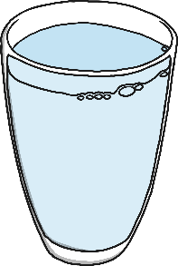
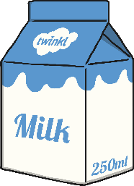
Variables
The variable you are testing is the thing you change every time you carry out the test.
In the comparative and fair tests we will look at this, it will be the liquids.
I want to change the liquids to see if different types of liquids have a particular effect on the chewing gum.

Slide 46
Variables
When you are carrying out a fair test, you need to change only one thing. All other variables should be kept the same so that they don’t affect your results.
In my tests I want to know if liquids change the colour of chewing gum but if I use different containers to put the liquid in or put the containers in different parts of the room then it could be the material of the containers that has the effect or the place in the room, not the liquid. These differences would mean I was testing lots of types of variables when I just want to test one type - liquid.
That’s why we have to keep some things the same throughout so that we know what is having the effect.

Slide 47
Variables
In my tests I would want the following things to be the same:
Containers
Where I place the containers
The amount of liquid in each container
The time between each observation
The type of chewing gum
The amount of chewing gum in each container.

Slide 48
Carrying Out Fair and Comparative Tests
Question: Do different liquids affect the colour of chewing gum?
Liquids (milk, water, orange juice)
Colour
Containers
Where I place the containers
The amount of liquid in each container
The time between each observation
The type of chewing gum
The amount of chewing gum in each container.
Record observations at regular intervals of time.
Compare the results from different liquids.
Spot patterns.
Liquid | Observation after 1 day. | Observation after 2 days.

Slide 49
Friday Maths lesson 5
Learning Objective
Using and applying
Friday Math Challenge
Most suitable questions for year 4 are 1,2,3,4,5
Demonstration click on left hand side of page for demo before clicking on activity or answers ( see next slide)
https://whiterosemaths.com/homelearning/year-4/
Questions
https://wrm-13b48.kxcdn.com/wp-content/uploads/2020/04/Family-Challenge-Friday-24th.pdf
Answer sheet
https://wrm-13b48.kxcdn.com/wp-content/uploads/2020/04/Answers-Week-1.pdf
Notes:
Odd and even numbers recapped due to following part of session
Support given to PP first and boys
teacher/ta work with LA group to support – teach how to answer

Slide 50
Friday English
Learning Objective
Write grammatically correct sentences using different sentence starters
(Start your answers with one of these generalisers. These are words that sum up things e.g. most, all, some, many, a few.)
Steps to Success:
1. Read instructions.
2. Read questions.
3. Answer questions using the different sentence starters - Most, All, Some, Many, A few
4. Follow instructions to the end of page 9
Complete challenge on p 9
English
‘Amazing Aliens’
https://www.talk4writing.co.uk/wp-content/uploads/2020/04/Y4-Maria-Aliens.pdf
Pages of unit p 8/9
Notes:
Odd and even numbers recapped due to following part of session
Support given to PP first and boys
teacher/ta work with LA group to support – teach how to answer

Slide 51
Friday
Spelling https://content.twinkl.co.uk/resource/b1/a1/T2-E-41609-Year-3-and-4-Statutory-Spelling-Words-Activity-Mat-2-Resource-Pack-English_ver_1.pdf?__token__=exp=1589124417~acl=%2Fresource%2Fb1%2Fa1%2FT2-E-41609-Year-3-and-4-Statutory-Spelling-Words-Activity-Mat-2-Resource-Pack-English_ver_1.pdf%2A~hmac=0756079d1504a8f947f3b06b3264da6cac140131a67f988bee94dcb48c237d8a
Learning Objective- To spell words from the statutory list
Steps to success
1.Use a dictionary to find the meaning of the word
2. Which word class does the word belong to? (see word mat)
3. Complete sentences
4. How many syllables does it have?
Complete all activities on the sheet below the spelling sheet
A syllable is a single, unbroken sound of a spoken (or written) word. Syllables usually contain a vowel and accompanying consonants. The number of times you hear a vowel (a, e, i , o, u) in a word is equal to the number of syllables a word has.
5. Spell the word
6. Edit the words
7. Write your own sentence with the word in

Slide 53
Friday spelling activities

Slide 54
Friday Topic Science
Learning Objective
To research what causes tooth decay
Steps to Success:
Think about your previous investigation on what the liquids did to the chewing gum.
What might happen to your teeth?
Watch the video clip
Create a poster that explains what tooth decay is and why we should brush our teeth.
Watch the video clip
https://www.youtube.com/watch?v=aOebfGGcjVw
Now create your poster filled with facts about what tooth decay is and why we should brush our teeth.
Remember to email us your posters as we would love to see them.
Notes:
Odd and even numbers recapped due to following part of session
Support given to PP first and boys
teacher/ta work with LA group to support – teach how to answer

